Slide 1

NAME=SRUSHTI MUDHOLKAR
ROLL NO.=IT-2K19-60
TOPIC=SRS OF CUSTOMER COMPLAINT MANAGEMENT SYSTEM

Slide 2
WHAT IS SRS
SRS stands for System Requirement Specifications. It is a document used to describe behaviour of software System, functional, non-functional requirement of software system.

Slide 3
PURPOSE
Customer Complaint is important information reflecting customers sound and is a primary measure of customer dissatisfaction. An Effective and Efficient response to these complaints is an essential index of organization's performance. The presented model for the Customer Complaint Management System will have the ability to minimize customers' dissatisfaction and on the other hand it can encourage customers to participate in controlling the quality of the service provided.

Slide 4
SCOPE
The scope of the system is quite wide. It can be implemented on a WAP-enabled mobile handset, thus providing the Customers and the Providers, the ease of accessing the projects and their status without any difficulty and within no time.
More specifically, this system is designed to allow a customer to be able to track the complaint status and be able to upgrade and renew their plans through the software.This is also developed for reducingthe communication cost between the staffs and to provide the efficient service to their staffs.Furthermore,CMS will not just have automation but , security and report generation facilities too.

Slide 5
Overall Description
The CMS has following modules
•Login and session management.
•Registration module.
•Operation module.
•User activity module.
•Search module.
•Report generation module.
•Database administration module.

Slide 6
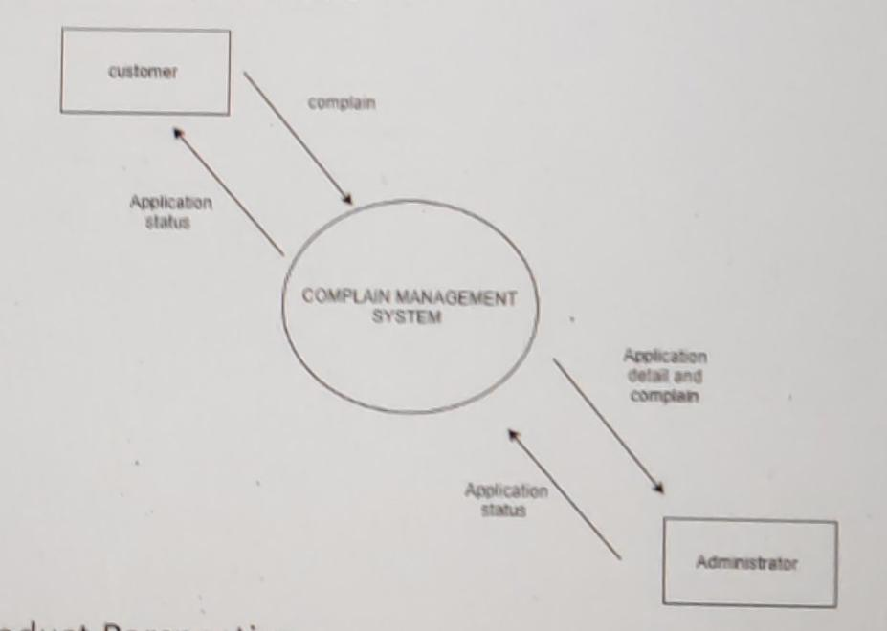

Slide 7
Product Functions
•Manage complaint requests for the client.
•Manage employee database for problem-solving enhancement.
•Allow users to track their complaint status.
•Allow users to manage their connection and perform tasks like top-up, recharge, and renewal from the software.

Slide 8
HARDWARE REQUIRMENTS
Processor :Intel Core 2 Duo or Above
System bus: 32 bits
RAM :2GB of RAM
HDD :100 GB or higher
Monitor :SVGA COLOR
Keyboard :108Keys
Mouse: 2 button mouse

Slide 9
SOFTWARE REQUIREMENT
Operating System: MS WINDOWS XP or Above
Environment: java Runtime Environment7
Front end :JSP
Additional languages :Core java, Servlet, JavaScript, Beans, HTML, CSS, Tomcat
Back end :MySql.

